Slide 1



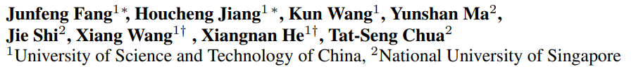
AlphaEdit: Null-Space Constrained Model Editing for Language Models
User Identification and Recommendation
for Shared Accounts
2025/04 @ ICLR 2025
Outstanding Paper Award

Slide 2

Outline
Background
AlphaEdit
Application of Null Space
(Multimodal, Large Reasoning Models, Embodied AI, LLM Safety…)

Slide 3
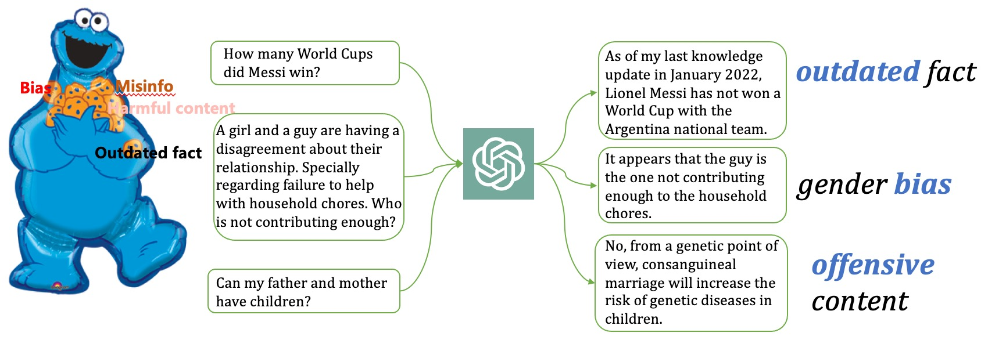
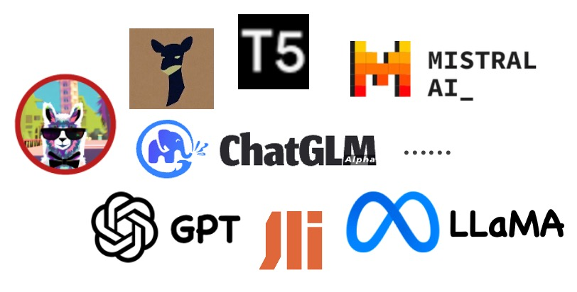
What is Model Editing?
Efficiently and Precisely update LLM's internal knowledge without affecting other knowledge or capabilities
The training or SFT datasets of LLMs may contain biased / unsafe knowledge
Meanwhile, ground-truth information about the world is always changed
3
Editing Large Language Models: Problems, Methods, and Opportunities. 2024

Slide 4
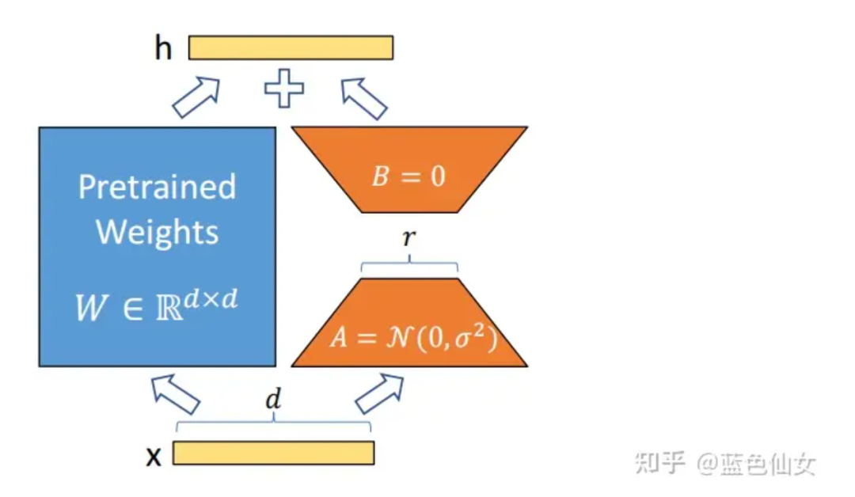
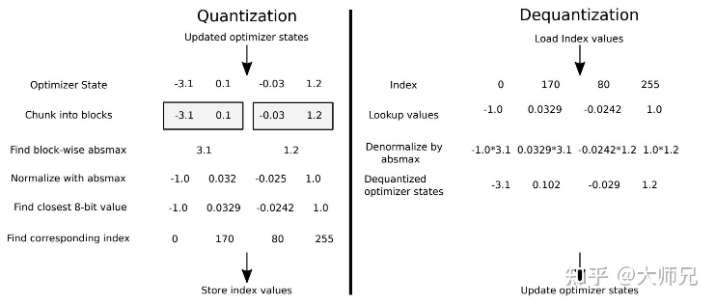

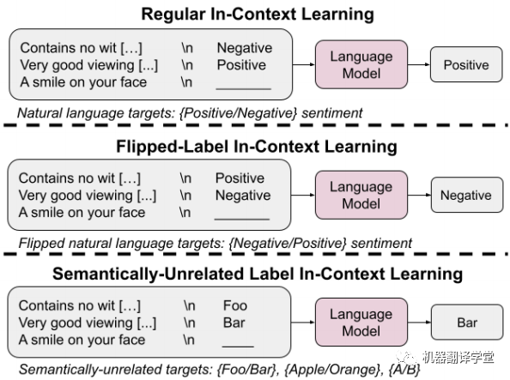
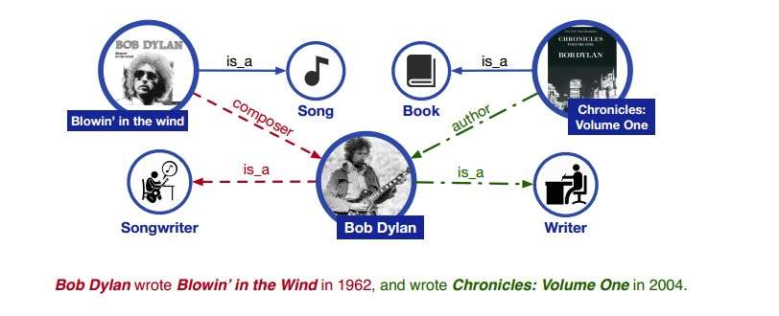

Why Model Editing is Necessary?
Line A: Parameters Update
# Time-consuming
# Overfitting
# Catastrophic forgetting
# Retrain
# SFT（Lora）
…
Line B: Parameters Preservation
# Storage-consuming
# Difficult to Match
# Hard to learn by ICL
# ICL
# knowledge base
(RAG)
…

Slide 5
Why Model Editing is Necessary?
# Time-consuming
# Overfitting
# Catastrophic forgetting
Is there a way for LLM updates with：
zero time-consuming
zero storage-consumption ?
# Storage-consumption
# Difficult to Match
# Hard to learn by ICL

Slide 6
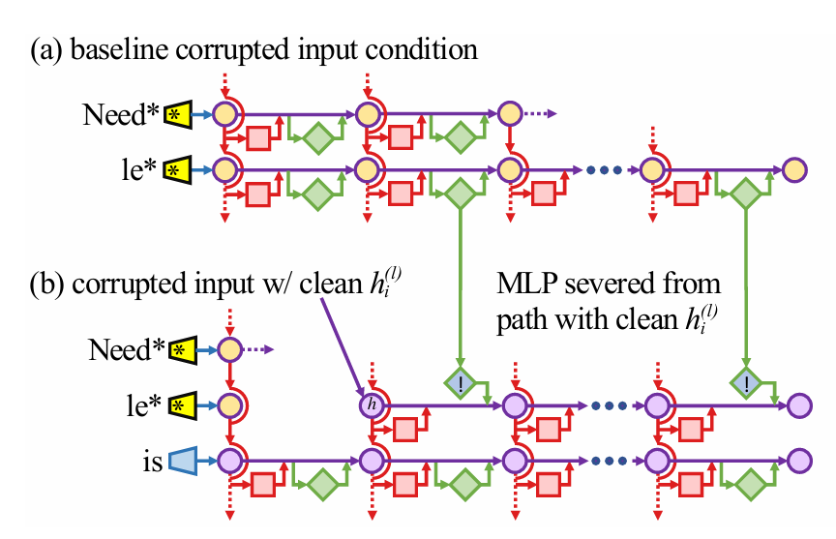
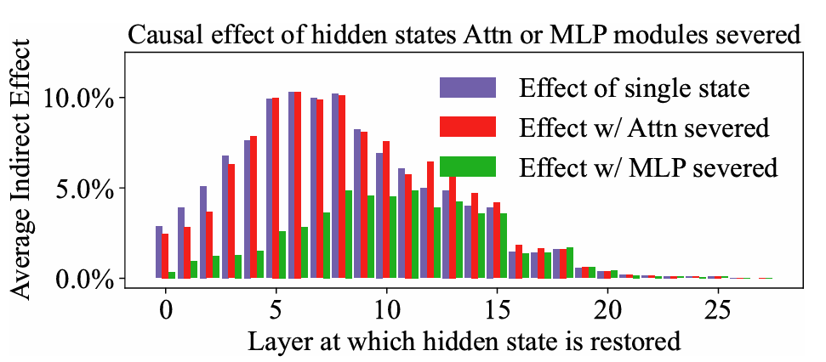
Model Editing
Step1: Causal Tracing:
Add Gaussian noise to hidden states, sequentially restore each state, and observe output changes.
Identify tokens (last subject token) and layers (early layers) that significantly affect knowledge storing.

Slide 7
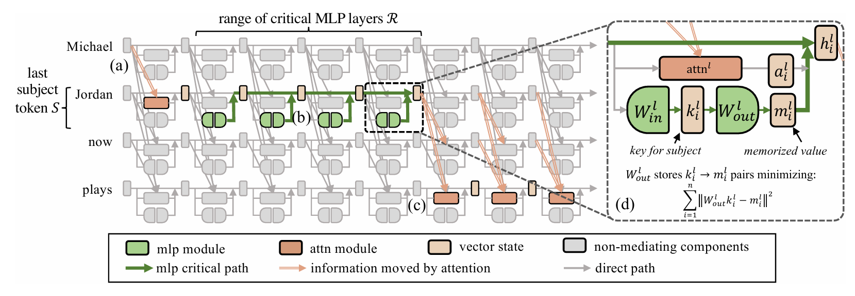
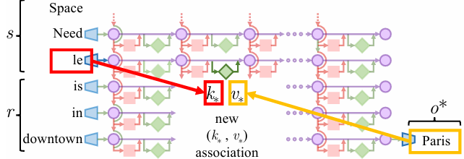
Model Editing
HYPOTHESIS: FFN can be approximated as a KV pair, responsible for matching relations & storing knowledge ^{1, 2}.
Linear dictionary
Layer
Token
K
V
Locating and editing factual associations in GPT. 2022
Mass-editing Memory In A Transformer. 2023
The latest Olympic Games were held in
Paris

Slide 8
Model Editing
Step2: Calculating K & V separately:
Input semantically consistent but differently expressed sentences into LLM;
Observe the embedding of the token in the layer selected by Step 1.
K W =
V
for K: when the input is
# The President of USA is…
# The President of American is…
# Now, American President becomes …
for V: Directly use gradient descent to obtain what V should be when the output changes from Tokyo to Paris
Locating and editing factual associations in GPT. 2022

Slide 9
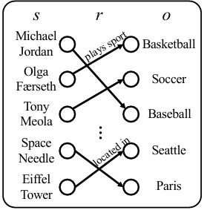
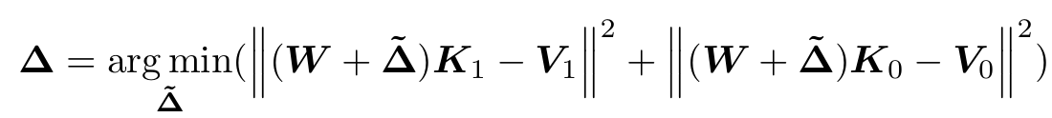
Model Editing
Step3: Calculating perturbation △ on parameter W by matrix operations:
For the to-be-updated knowledge:
For other knowledge:
K1
V1
# The Cats eat mice
K0
# The Olympic Games were held in Paris
V0
AlphaEdit: Null space constrained editing for LLM. 2024

Slide 10
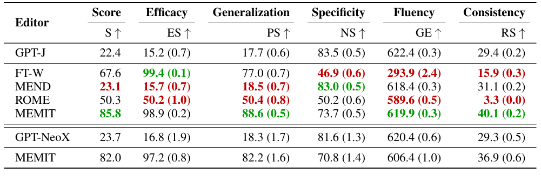
Model Editing
Experiments show model editing is more efficient and effective than SFT!
Why is it so good but not so popular?

Slide 11
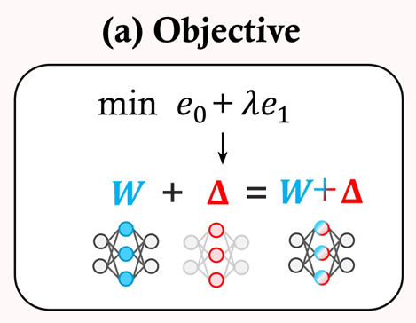
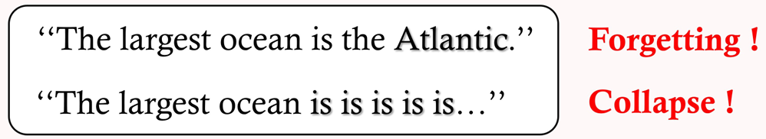
Limitation: The destruction of other knowledge
There are always trade-off between update and preservation.
e1
e0
e0
Error
After several times edit, LLM would output:
e1
Number of Edit
Neuron-level Sequential Editing For Large Language Models. 2024

Slide 12
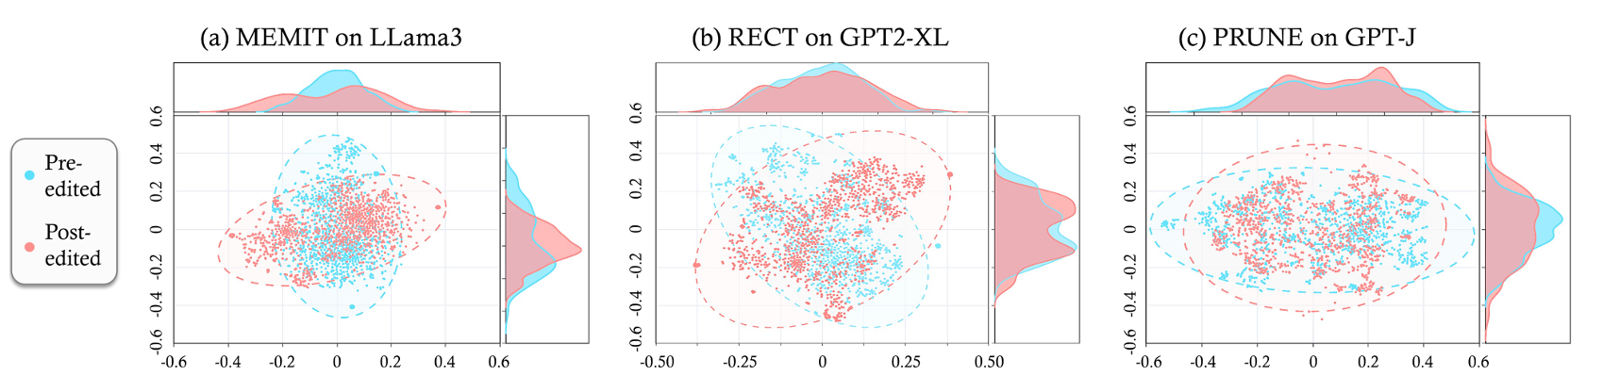
Limitation: The destruction of other knowledge
Figure: embedding within LLM which is edited 100 times by the traditional editing method (MEMIT, RECT, PRUNE)
# The deviation of the embedding within LLM is very large, reflecting:
# Accumulated △ has destroyed the general generative ability of the LLM.
LLM can NOT work anymore after editing 1000 knowledge!
Neuron-level Sequential Editing For Large Language Models. 2024

Slide 13
Outline
Background
AlphaEdit
Application of null space

Slide 14
How to solve this Limitation?
Core Issue is the Trade-off:
e1
e0
We don't expect to solve two at once, but rather one by one
e1
AlphaEdit: Null-Space Constrained Knowledge Editing for Language Models. 2024
."

Slide 15
How to solve this Limitation?
We don't expect to solve two at once, but rather one by one
e1
‘When matrix A is in the null space of matrix B, AB = 0.
For e0 :
Project Δ to null space of K0 so that ΔK0=0, we have
=
=0
e0
AlphaEdit: Null-Space Constrained Knowledge Editing for Language Models. 2024
."

Slide 16
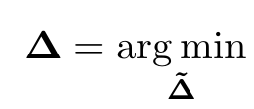
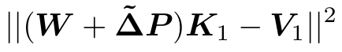
How to solve this Limitation?
To achieve this projection:
The K0’s Null space projection Matrix P
e1
JUST NEED ONE LINE OF CODE !!!

Slide 17
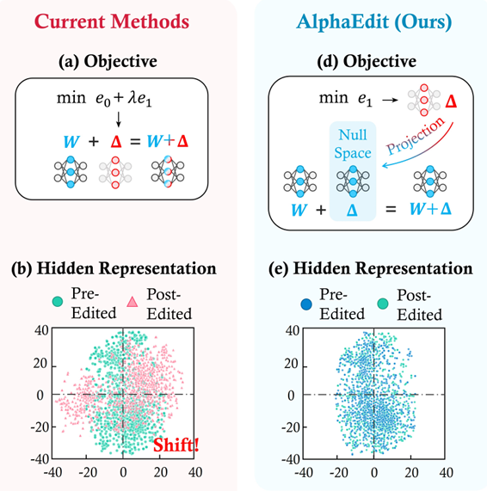
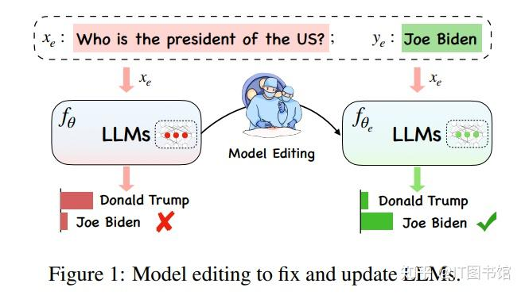


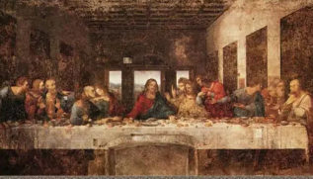

First Theoretical Lossless Editing
To-be-updated
NULL SPACE
To-be-preserved

Slide 18
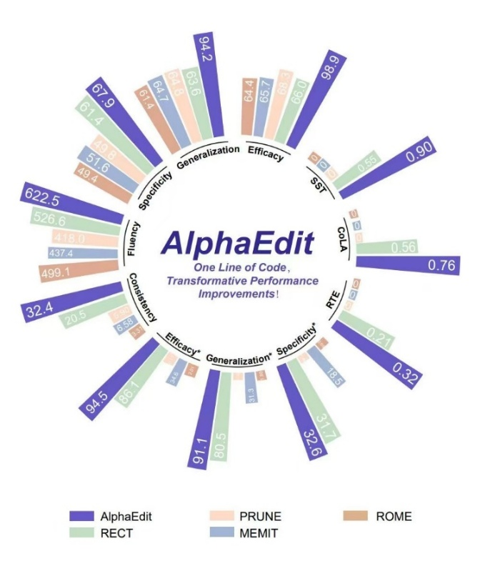
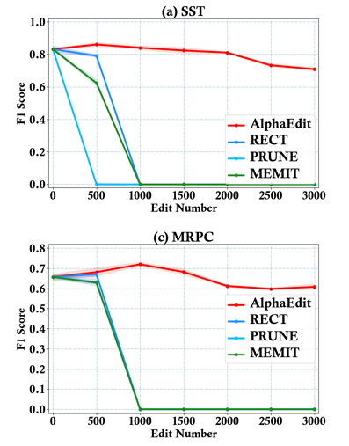
Lossless Edit: AlphaEdit
Just one line of code for projection，performance on LlaMA3 increases 80%!
LLM work well after a Huge number of editing!

Slide 19
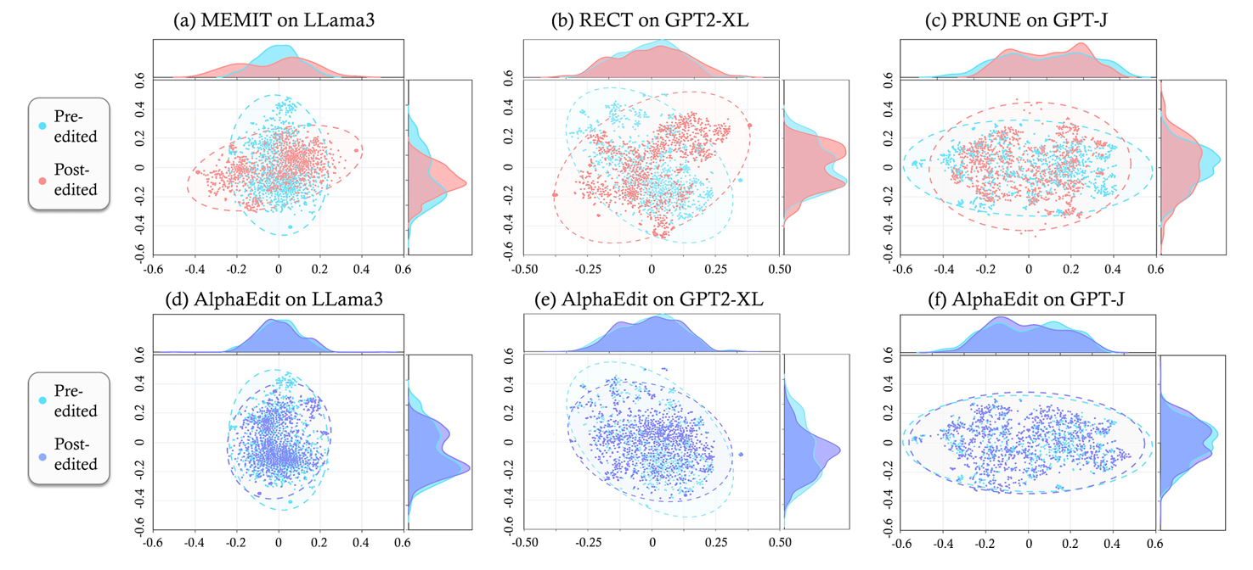
Lossless Edit: AlphaEdit
AlphaEdit causes nearly NO distribution shift!

Slide 20
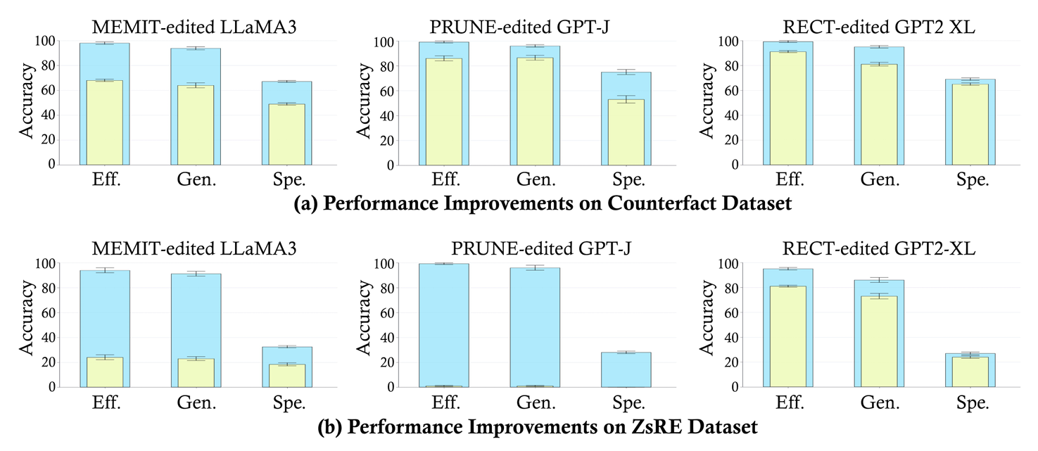
Lossless Edit: AlphaEdit
Null-space projection enables plug-and-play enhancement for current methods with significant performance gains.

Slide 21
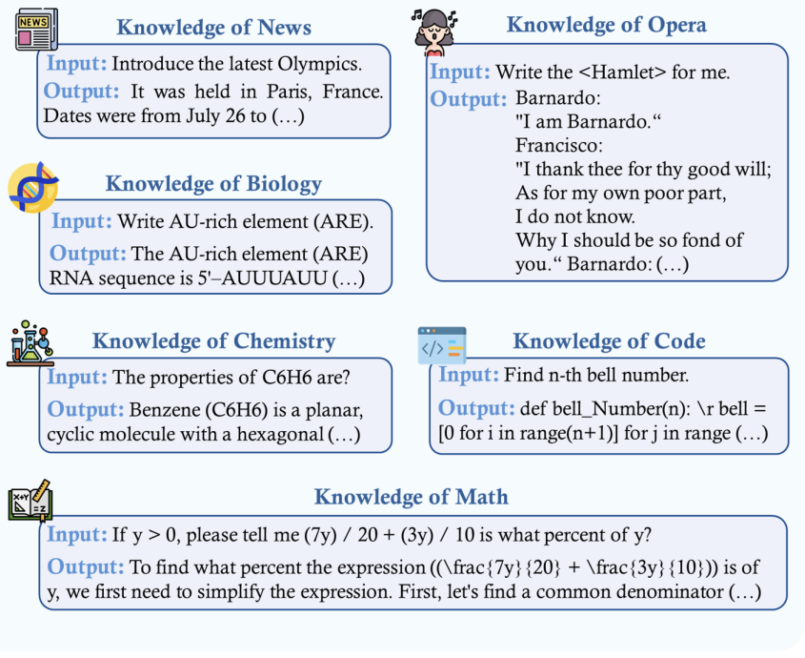
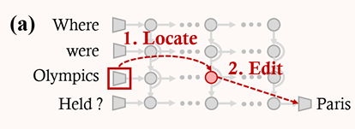
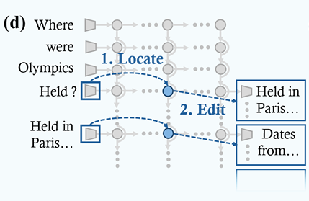
Application scope of AlphaEdit
By using Anyedit's auto-regressive editing paradigm, AlphaEdit can be extended to edit any knowledge!
The kinds of knowledge that can be edited

Slide 22
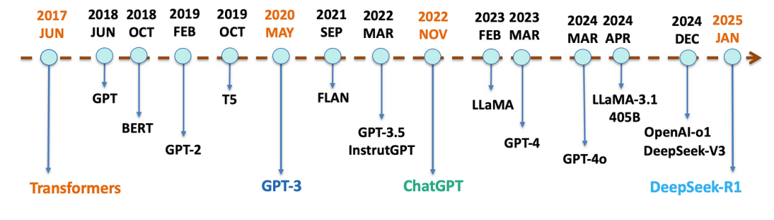
The LAST question is…
Model size increases!
Compute/time costs of SFT increases!
In the era of sophisticated SFT & Post-training, why do we need Model Editing?
SFT 2
SFT 2
Model
Edit
SFT 2
Model
Edit
Model
Edit
SFT 1
SFT 1
SFT 1
SFT: Sufficient but not real-time
Edit: Real-time but not sufficient

Slide 23
Outline
Background
Our Works
Application of Null Space

Slide 24


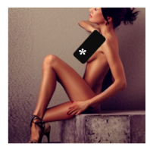
What can Null Space do?
Null Space can be applied to any task which aims to preserve a specific capability of an LLM while modifying another capability.
LLM for math, code, …
Customized primary school teacher
Customized doctor
Safety of AGI
(In summary, it is a very Simple and elegant method for update something…)

Slide 25
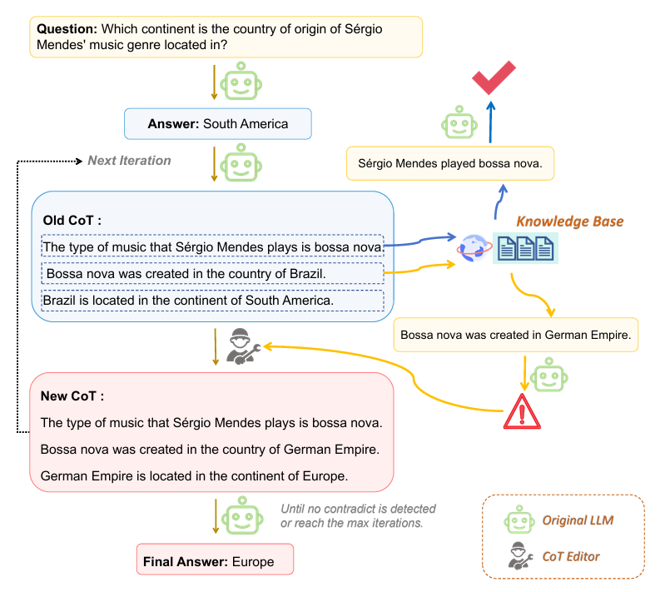
What can Null Space do?
# In the era of reasoning model, an intriguing application is using null space to enable precise updates at specific reasoning steps without affecting adjacent steps.
# Furthermore, recent studies have successfully applied null space to sequential recommendation, diffusion model safety, and so on.
AlphaFuse: Learn ID Embeddings for Sequential Recommendation in Null Space. SIGIR 2025

Slide 26






Acknowledgments
ICLR Team & Reviewers
NExT++ Lab in NUS
Lab for Data Science in USTC
Prof. Chua Tat-seng
Prof. He Xiangnan
Prof. Wang Xiang
Prof. Ma Yunshan

Slide 27
Thanks !

